Slide 1
Data Science UNIT-I Hypothesis Testing (Introduction, Z-Test, P-Test, T-Test)

Slide 2
Basic Terms
Population : all possible values
Sample : a portion of the population
Statistical inference : generalizing from a sample to a population with calculated degree of certainty
Two forms of statistical inference
Hypothesis testing
Estimation
Parameter : a characteristic of population, e.g., population mean µ
Statistic: calculated from data in the sample, e.g., sample mean ( )
Notes:
Hypothesis testing is one of the two common forms of statistical inference. This slide reviews some of the terms that form the basis of statistical inference, as introduced in the prior chapter. Make certain you understand these basics before proceeding.

Slide 3
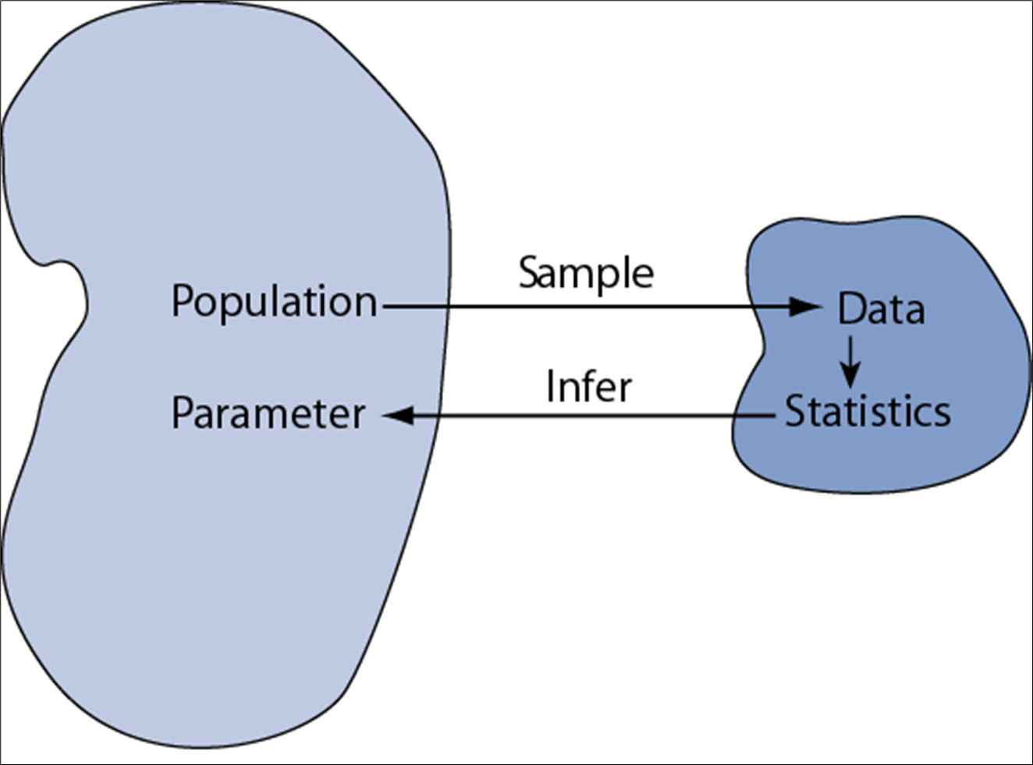
Examples:
Population vs sample
Population | Sample
Advertisements for IT jobs in the India | The top 50 search results for advertisements for IT jobs in the India on May 1, 2020
Songs from the Eurovision Song Contest | Winning songs from the Eurovision Song Contest that were performed in English
Undergraduate students in the India | 300 undergraduate students from three TG,AP,TN universities who volunteer for your psychology research study
All countries of the world | Countries with published data available on birth rates and GDP since 2000

Slide 4
What is hypothesis?
Hypothesis is a claim made by a person/organization
A hypothesis/claim is an assumption about the population
parameter.
A parameter is a Population mean or proportion
The parameter must be identified before analysis.
claim could be that the average salary of analytics experts is at least USD 1,00,000).
I assume the mean GPA of this class is 3.5!

Slide 5
Hypothesis Testing
Is also called significance testing
Tests a claim about a parameter using evidence from a sample for the support of the claim
Hypothesis testing is a technique to help determine whether a specific treatment influences the individuals in a population.
The technique is introduced by considering a one-sample z test

Slide 6
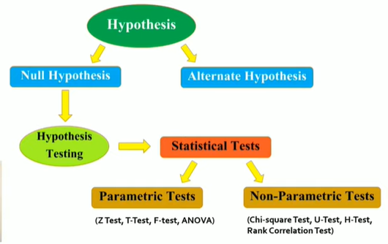
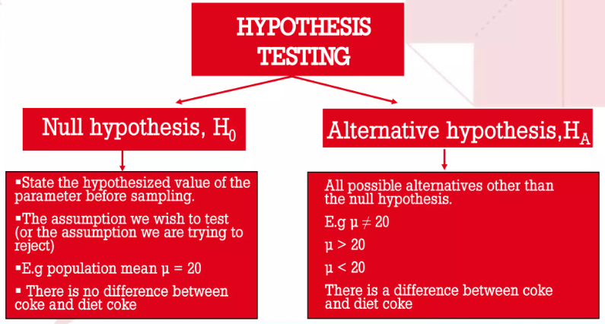

Slide 7
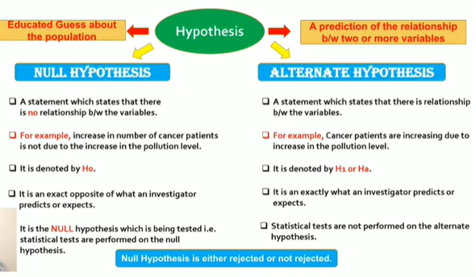

Slide 8
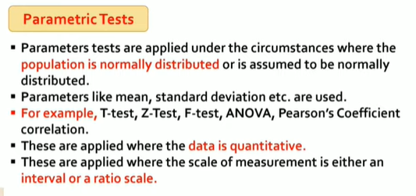
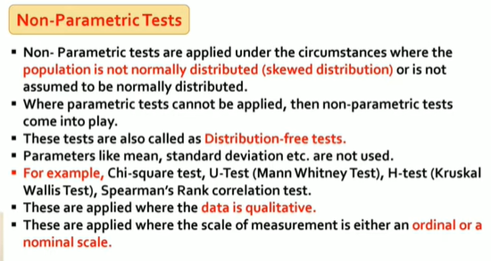

Slide 9
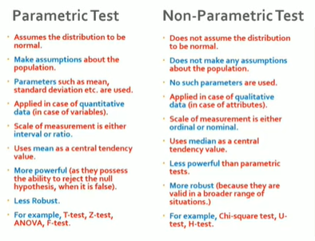

Slide 12
Steps in Hypothesis Testing
▪
▪
Specify the population value of interest
Formulate the appropriate null and alternative hypotheses
Specify the desired level of significance
Determine the rejection region
Obtain sample evidence and compute the test statistic
▪
▪
▪
▪
6. Re a c h a decisi o n a n d inter pr et the res ult
24

Slide 13
Steps in Hypothesis Testing
A Statistical hypothesis is a conjecture about a population parameter.This conjecture may or may not be true.
The null hypothesis, symbolized by H₀, is a statistical hypothesis that states that there is no difference between a parameter and a specific value or that there is no difference between two parameters.
The alternative hypothesis, symbolized by H₁, is a statistical hypothesis that states a specific difference between a parameter and a specific value or states that there is a difference between two parameters.
●
●

Slide 14
Steps in Hypothesis Testing
A statistical test uses the data obtained from a sample to make a decision about whether or not the null hypothesis should be rejected.
The numerical value obtained from a statistical test is called the test value.
In the hypothesis-testing situation, there are four possible outcomes.
In reality, the null hypothesis may or may not be true, and a decision is made to reject or not to reject it on the basis of the data obtained from a sample.

Slide 15
Steps in Hypothesis Testing
H₀ True H₀ False
Error Type I
Correct decision
Reject
H₀
Do not reject H₀
Correct decision
Error Type II

Slide 16
Steps in Hypothesis Testing
A type I error occurs if one rejects the null hypothesis when it is true.
A type II error occurs if one does not reject the null hypothesis when it is false.
The level of significance is the maximum probability of committing a type I error.
This probability is symbolized by α (Greek letter alpha).
That is, P(type I error)=α.
P(type II error) = β (Greek letter beta).

Slide 17
Steps in Hypothesis Testing
Typical significance levels are: 0.10, 0.05, and 0.01.
For example, when α = 0.10, there is a 10% chance of rejecting a true null hypothesis.
The critical value(s) separates the critical region from the noncritical region.
The symbol for critical value is C.V.
The critical or rejection region is the range of values of the test value that indicates that there is a significant difference and that the null hypothesis should be rejected.
The noncritical or nonrejection region is the range of values of the test value that indicates that the difference was probably due to chance and that the null hypothesis should not be rejected.

Slide 18
Critical Value Approach to Testing
▪
Convert sample statistic (e.g.: _{x} ) to test statistic ( Z or t statistic )
▪
Determine the critical value(s) for a specified level of significance α from a table or computer
▪
If the test statistic falls in the rejection region, reject H₀ ; otherwise do not reject H₀

Slide 19
Lower Tail Tests
H₀: μ ≥ 3
The cutoff value,
^{-z}α or ^{x}α, is called a critical value
H_{A}: μ < 3
α
Reject H₀
Do not reject H₀
-z_{α}
0
μ
x_{α}
σ
xα = μ − z
α
n

Slide 20
Hypothesis Testing - Example
A contractor wishes to lower heating bills by using a special type of insulation in houses. If the average of the monthly heating bills is $78, her hypotheses about heating costs will be
H₀: μ ≥ $78 H₁: μ < $78
This is a left-tailed test.

Slide 21
Upper Tail Tests
H₀: μ ≤ 3 H_{A}: μ > 3
The cutoff value,
z
or x, is called a
α
α
critical value
α
Do not reject H₀
Reject H₀
0
μ
z_{α}
x_{α}
σ
xα = μ + z
α
n

Slide 22
Hypothesis Testing - Example
A chemist invents an additive to increase the life of an automobile battery. If the mean lifetime of the battery is 36 months, then his hypotheses are
H₀: μ ≤ 36 H₁: μ > 36
This is a right-tailed test.

Slide 23
Two Tailed Tests
There are two cutoff values (critical values):
H₀: μ = 3
H_{A}: μ ≠3
^{± z}α/2
α/2
α/2
or
^{x}α/2
Lower
^{xα/2} Upper
Reject H₀
Do not reject H₀
Reject H₀
⁻ ^{z}α/2
0
μ₀
z
α/2
x
x
^{α/2} Lower
^{α/2} Upper
σ
xα/2 = μ ± z
α/2
n
19

Slide 24
Hypothesis Testing - Example
A medical researcher is interested in finding out whether a new medication will have any undesirable side effects. The researcher is particularly concerned with the pulse rate of the patients who take the medication.
What are the hypotheses to test whether the pulse rate will be different from the mean pulse rate of 82 beats per minute?
H₀: μ = 82 H₁: μ ≠ 82
This is a two-tailed test.

Slide 25
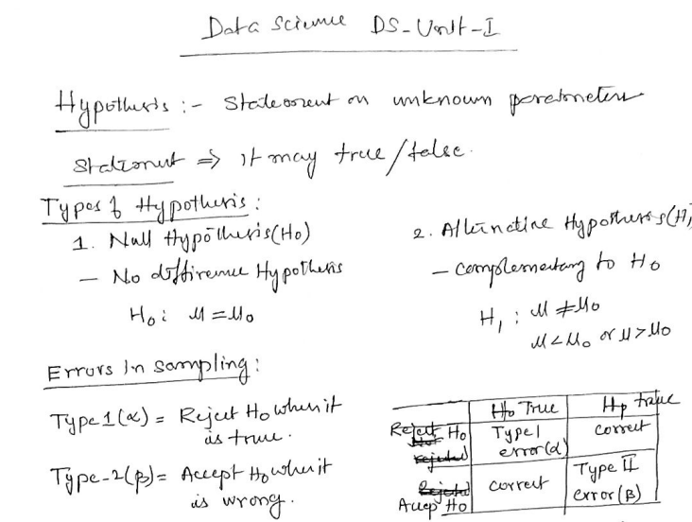

Slide 26
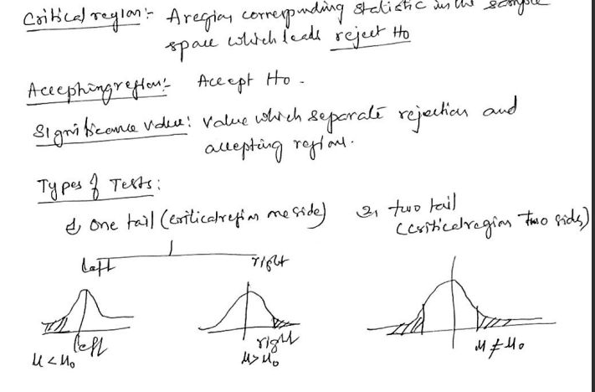

Slide 27
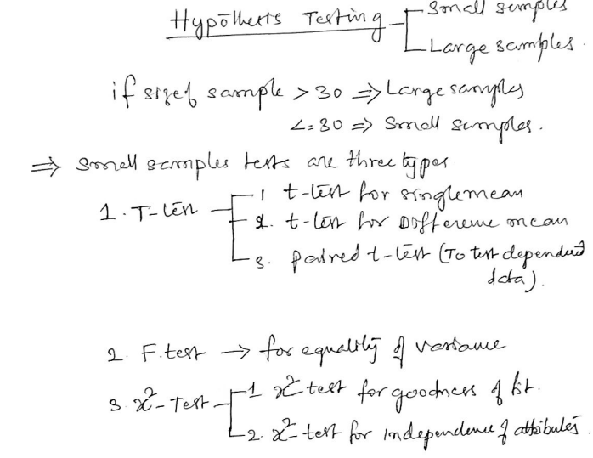
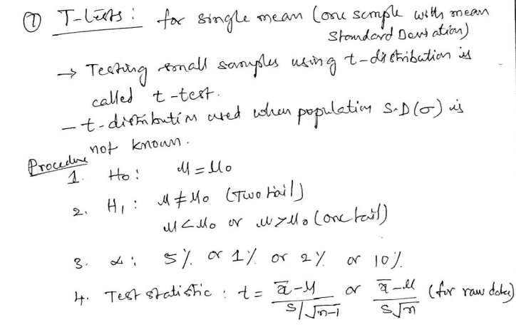

Slide 28
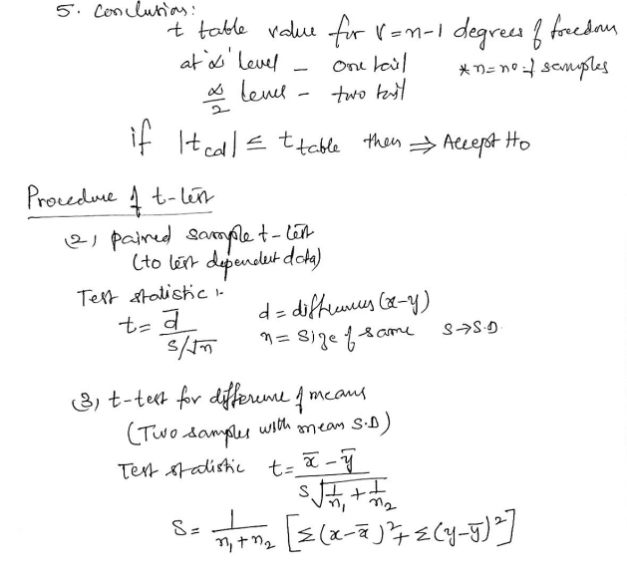
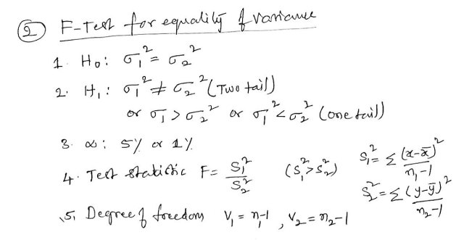

Slide 29
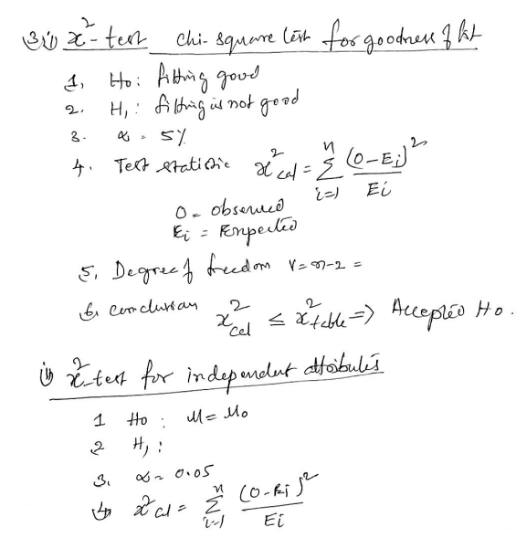

Slide 30
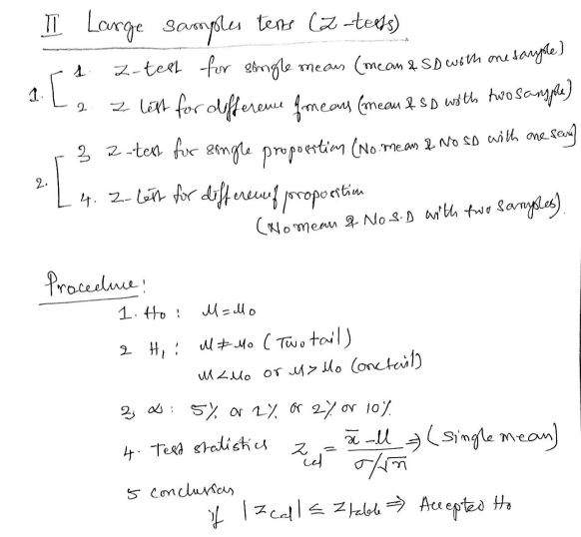
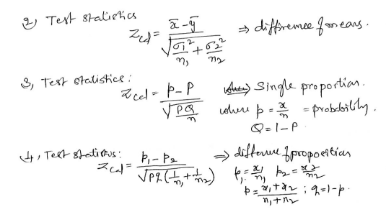

Slide 31
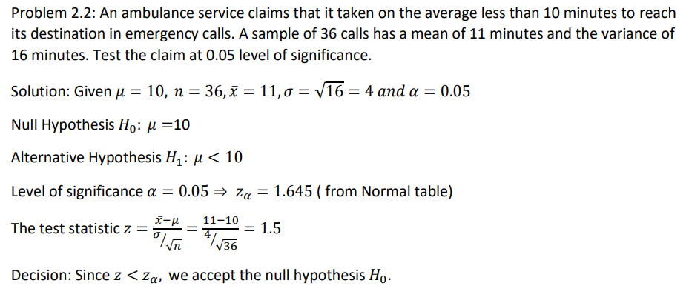

Slide 32
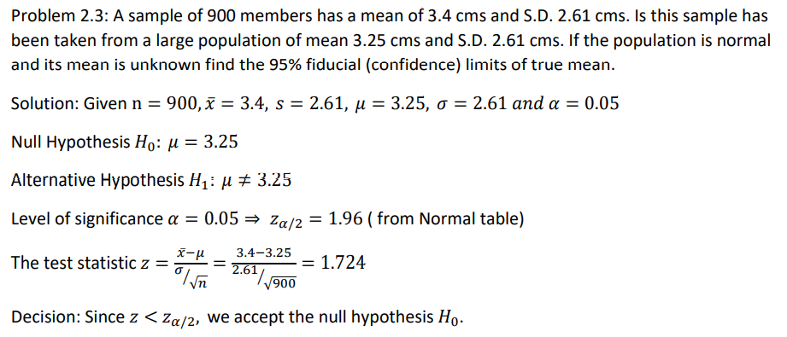

Slide 33
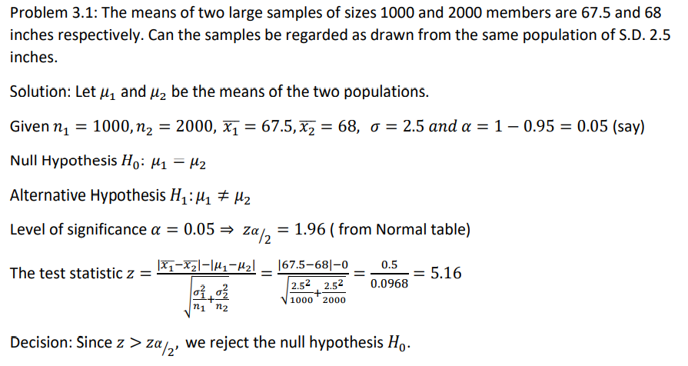

Slide 34
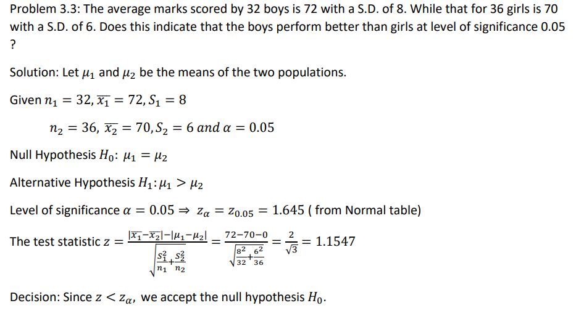

Slide 35
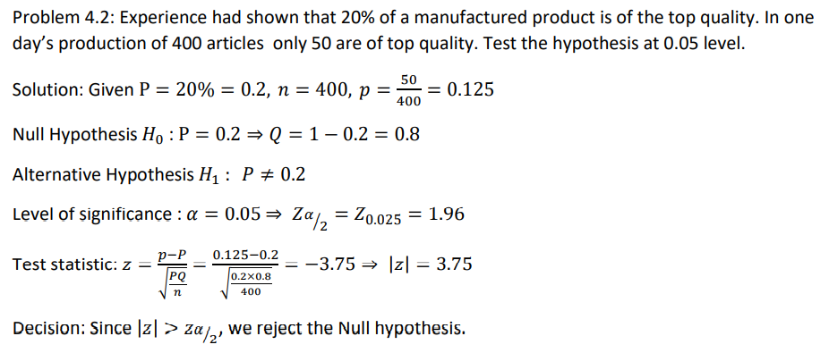

Slide 36
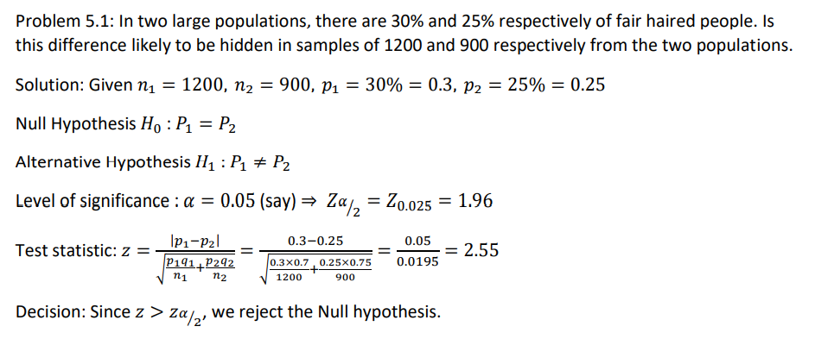

Slide 37
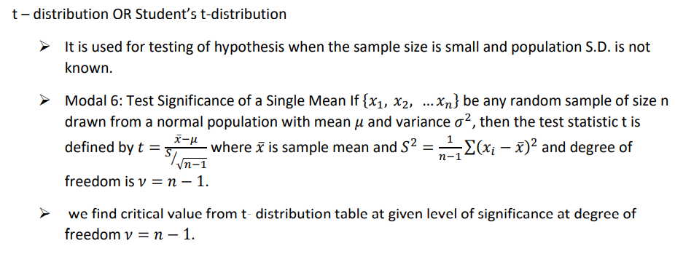

Slide 38
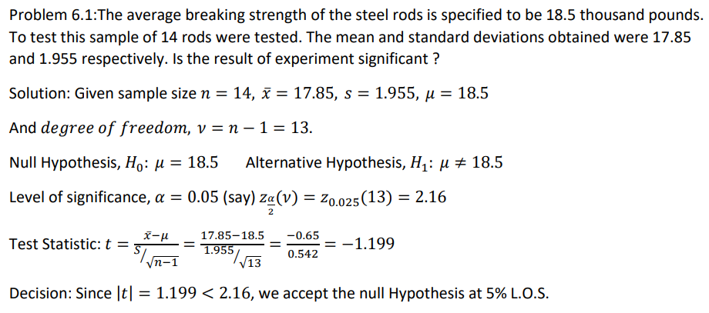

Slide 39
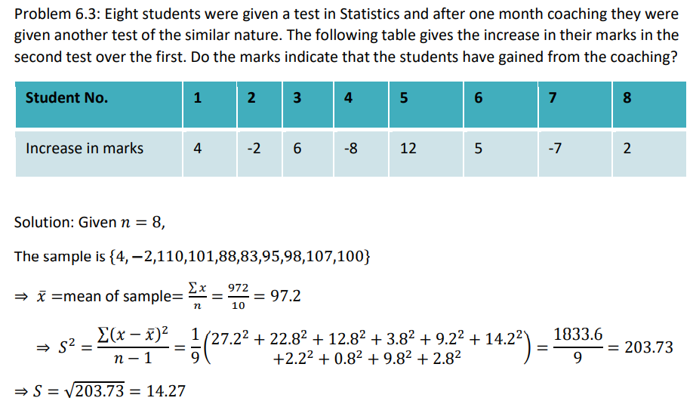

Slide 40
